Slide 2
HONEY START
A platform that gives a brand new wedding experience for couples and wedding guest

Slide 3
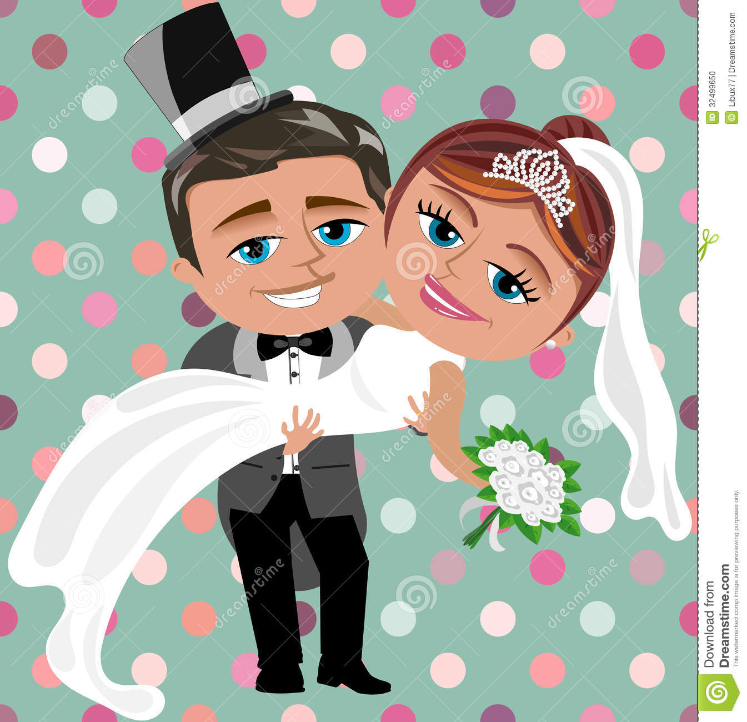

SITUATION
Wedding is expected to be
A Fun and engaging event
A celebration of wedding couples and their friends/relatives
Yet, now is is
A 3-month with tired and hectic preparation from bride and groom
An “eating party” of wedding guest

Slide 4
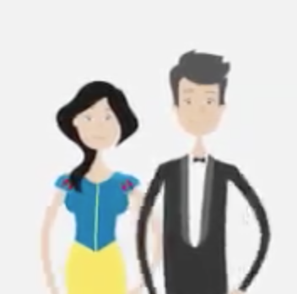
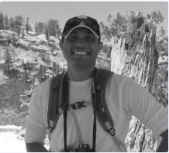

OUR SOLUTION
Honey start is the bridge of wedding couples, their friends
Couples
Beautiful wedding memory: Exclusive couple page with love stories and photo albums
Get support from friends 3 months prior to real ceremony (wedding pre-funding, blessing, sharings, etc.)
Guest
Have a feeling of actual contribution for their friend’s wedding
For wedding guest who are going to get married They can easily get the experience from current wedding couples

Slide 5

OUR SOURCE OF SPONSORSHIP
Wedding-related services
Reach potential customers as “Recommended services” on HS website & columns on HS’s monthly newsletter
Special offers for wedding couples and wedding couples-to-be

Slide 6
OUR VISION
Successfully launch/spread in Vietnam
Expand to other market with similar wedding practice (eg: China)

Slide 7
HOW WE DO IT
Create Honey Start website as content hub
Leverage Facebook as interaction and advertising platform

Slide 8
HOW DO WE SPREAD HONEY START
Wedding guest who are couple-to be are aware and interested to use Honey Start for their wedding
We advertise Honey start via Facebook platform
( Facebook sponsor, live stream, etc. with FB chat for customer support, CRM)
Last but not least, volunteers from this Hackathon event. We already got 1 friend signed up!

Slide 9
DEMONSTRATION
COUPLE JOURNEY:

Slide 10
COUPLE JOURNEY
See Honeystart from FB advertising
Visit honeystart.com
Create couple page
Share couple page on FB wedding event
Join the wedding that couples use Honey Start
Update wedding diary on FB wedding events

Slide 11
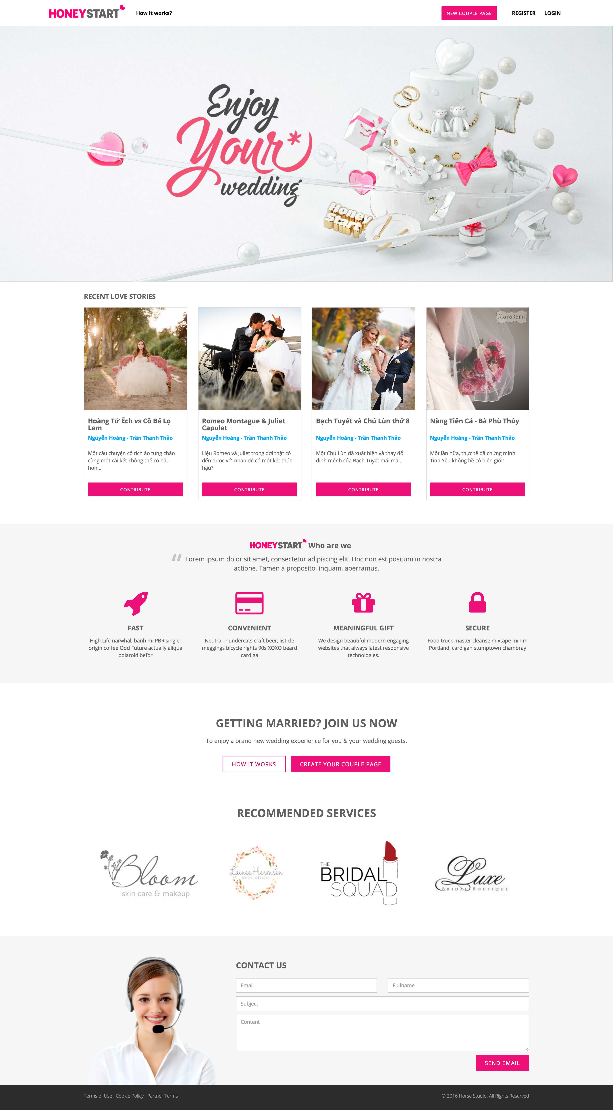
COUPLE JOURNEY
Visit honeystart.com
Create new couple page
Couple pages of different wedding couples
Click “Contribute” for Wedding pre-funding
Honey Start introduction
Call 4 actions for wedding couples to-be
Recommended services
Contact

Slide 12
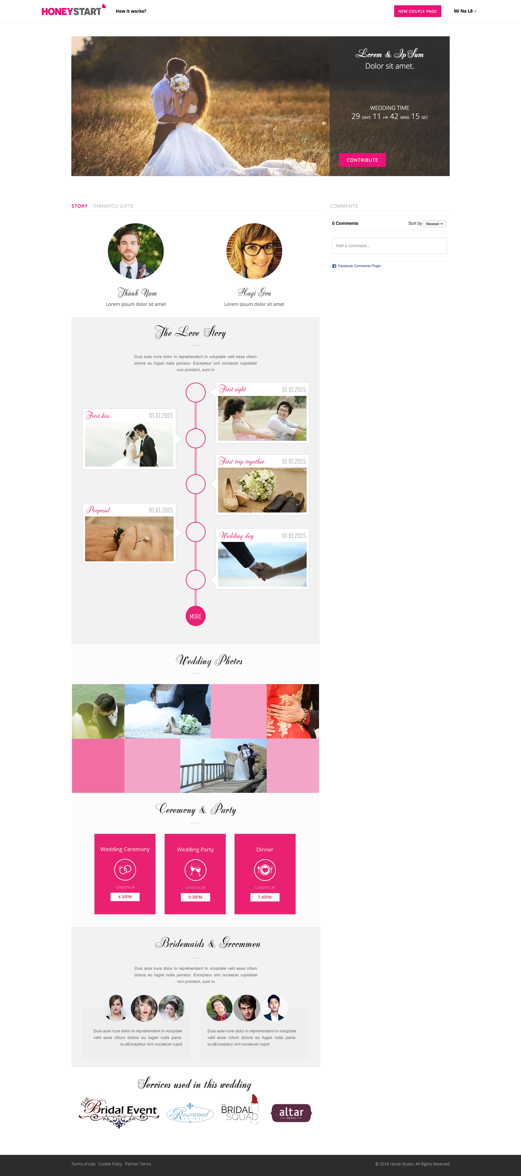
COUPLE JOURNEY
Automatic couple page generated
Wedding info
Couple image
Blessing comments, mirroring from FB events comments
Couple love stories
Wedding photos
Wedding info details
Bridemaids and groomen
Services use in this wedding

Slide 13
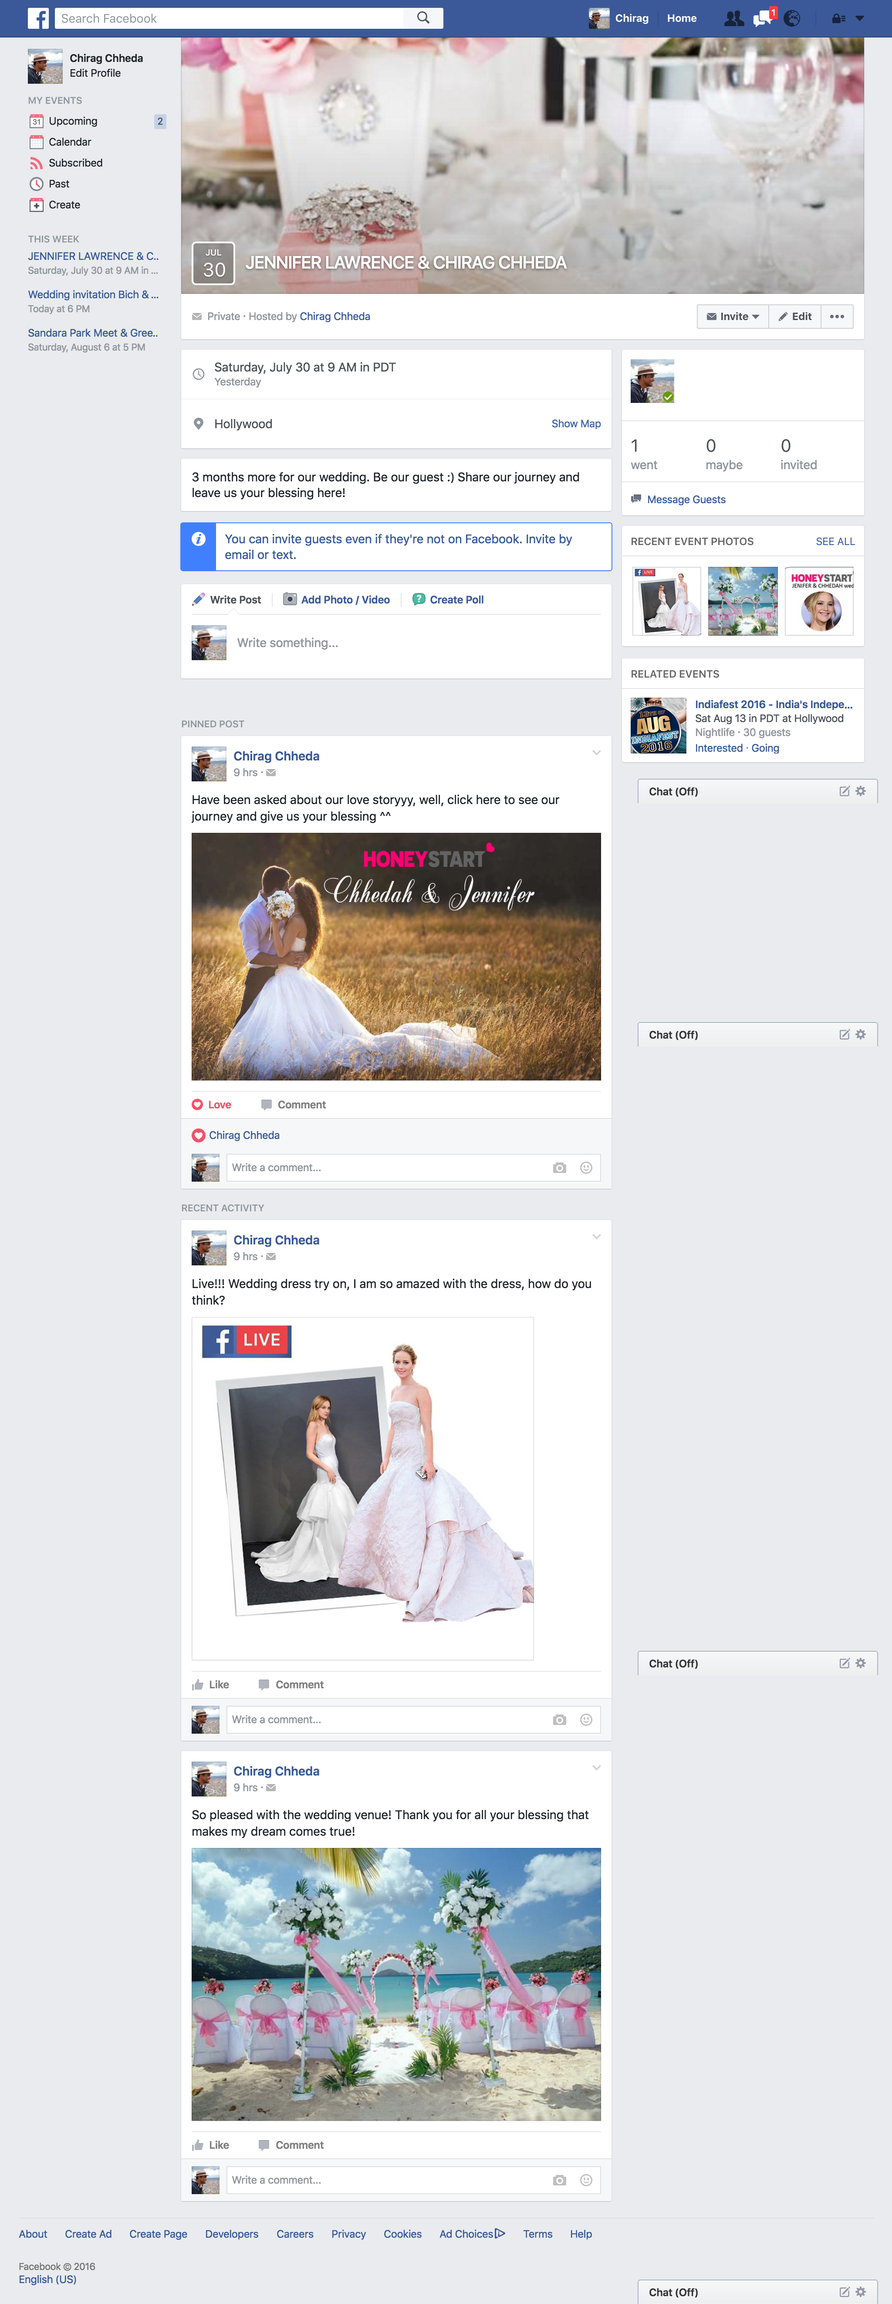
COUPLE JOURNEY
Share couple page on Facebook wedding event
Update wedding diary on FB wedding events
Pin post, link to Honey Start website
Comments under this pinned post will be mirrored to Honey Start’s couple page
Couples update their wedding diary and share with guests what they have prepared thanks to guest support

Slide 14
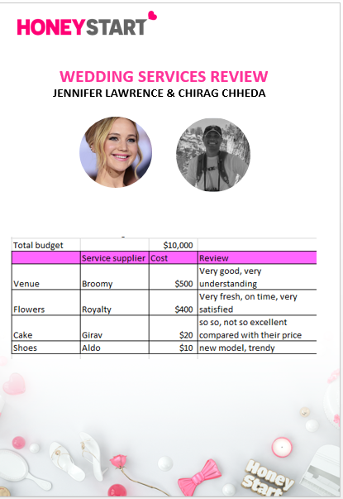
COUPLE JOURNEY
Document their wedding XP - Honey Start will refund their original deposit

Slide 15
DEMONSTRATION
WEDDING GUEST

Slide 16
JOURNEY
See Facebook invitation from their friends
Click to Honey start link on pinned post
View couple page
Pre-fund for wedding and Receive bonus services

Slide 17
WEDDING GUEST JOURNEY
See Facebook invitation from their friends
Click to Honey start link on pinned post
View couple page
Click for blessing/ore-funding

Slide 18
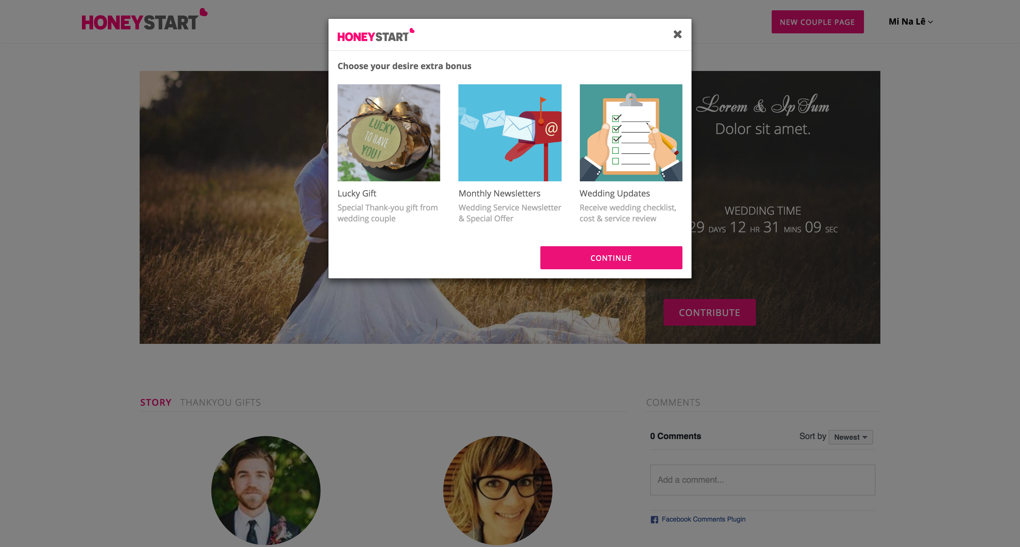
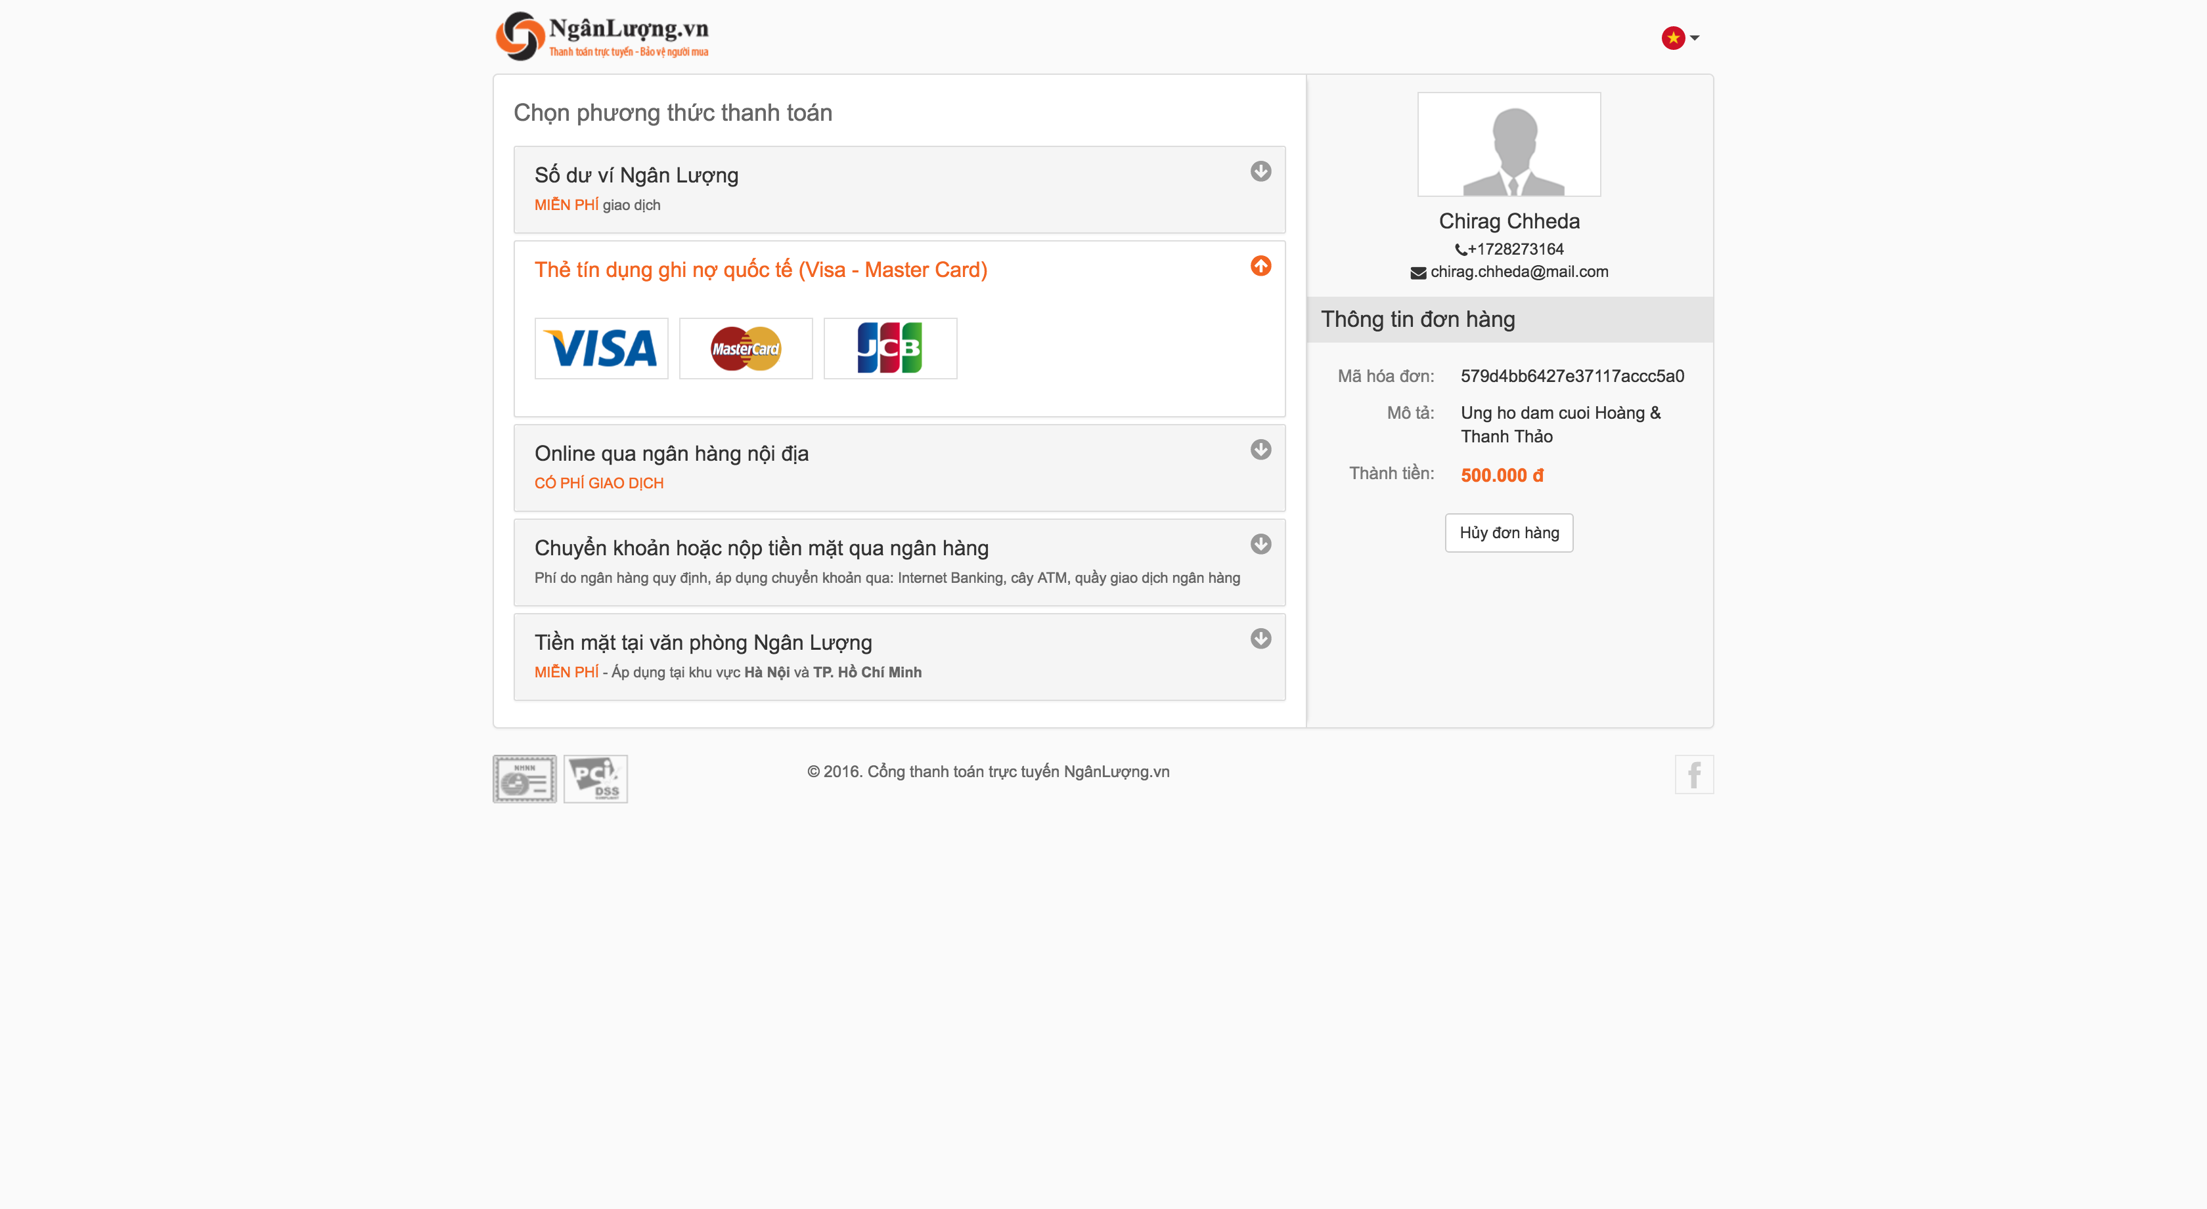

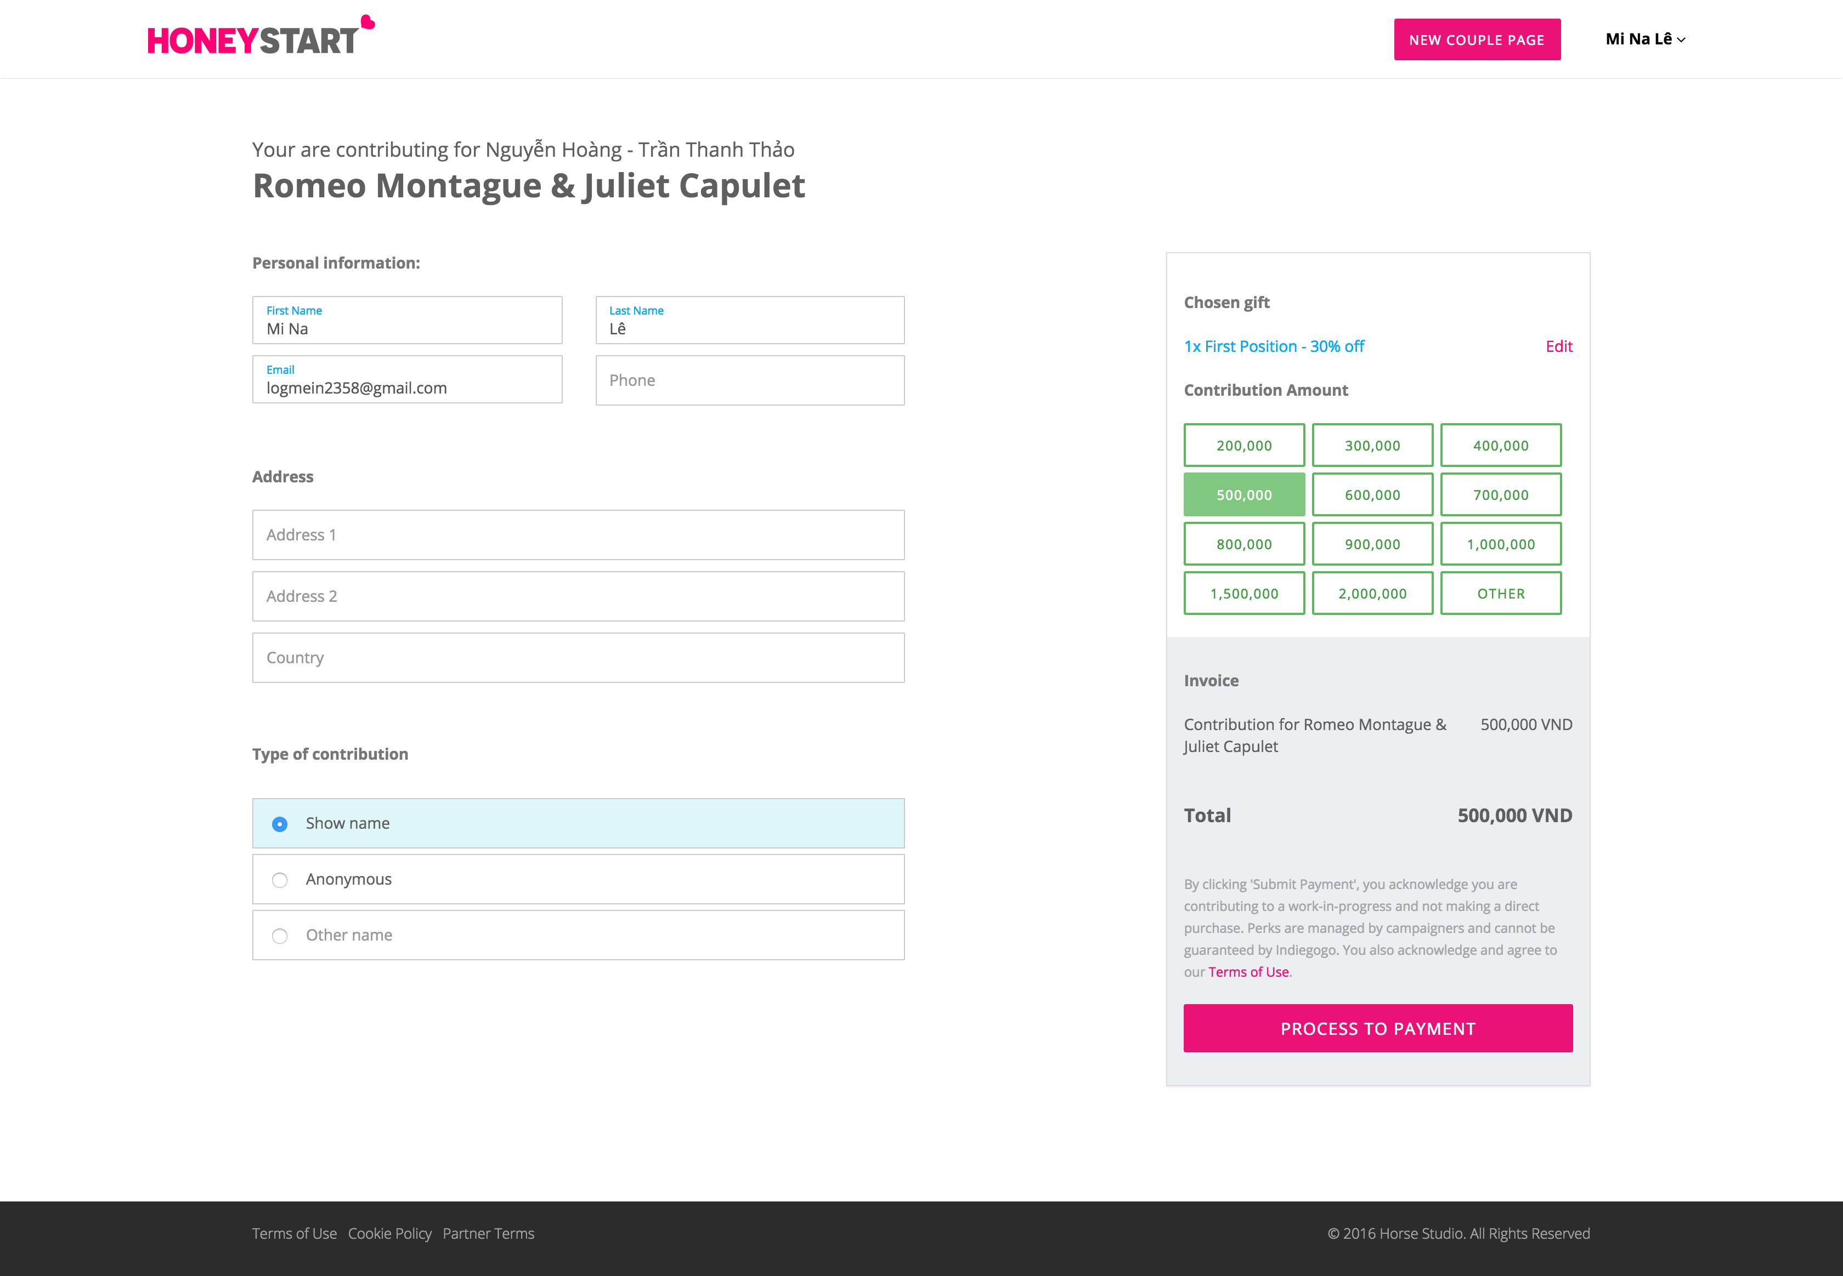
WEDDING GUEST JOURNEY
Choose bonus services
Pre-fund for wedding

Slide 19
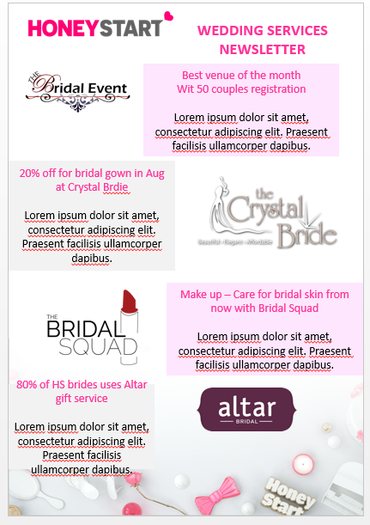
WEDDING GUEST JOURNEY
Receive bonus services

Slide 20
DEMONSTRATION
SPONSORS : WEDDING-RELATED SERVICES BENEFIT

Slide 21

SPONSORS BENEFIT
Recommended services
Monthly newsletter for potential wedding couple

